Slide 1
Bulk and single cell RNA Sequencing
Alper Celik
CCM
Nov 22 2022

Slide 2
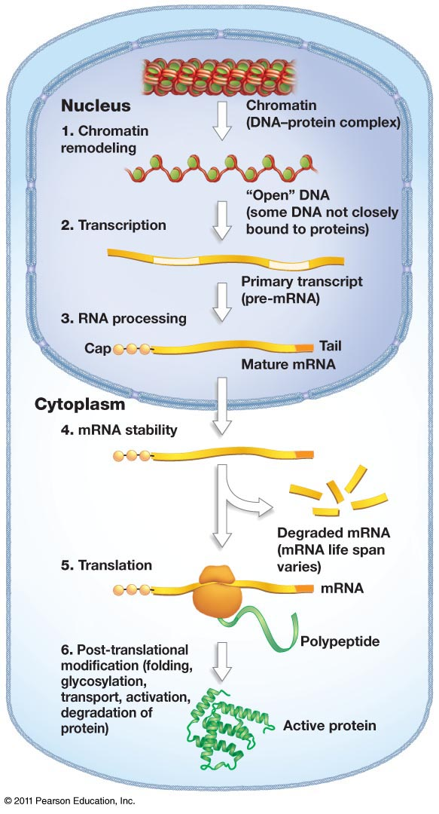
Sequencing as a tool
Why sequence RNA?
Gene Expression changes show effect of treatment.
A phenotypic consequence
e.g. Wild type versus knock out mice
Some changes are observed only at the RNA level
Splicing
fusion
RNA editing

Slide 3
Why sequence RNA?
Variant interpretation
Regulatory mutations
Splice changes
Variant Prioritization
Variant in unexpressed gene -- uninteresting!
allele specificity
candidate drug target genes

Slide 4
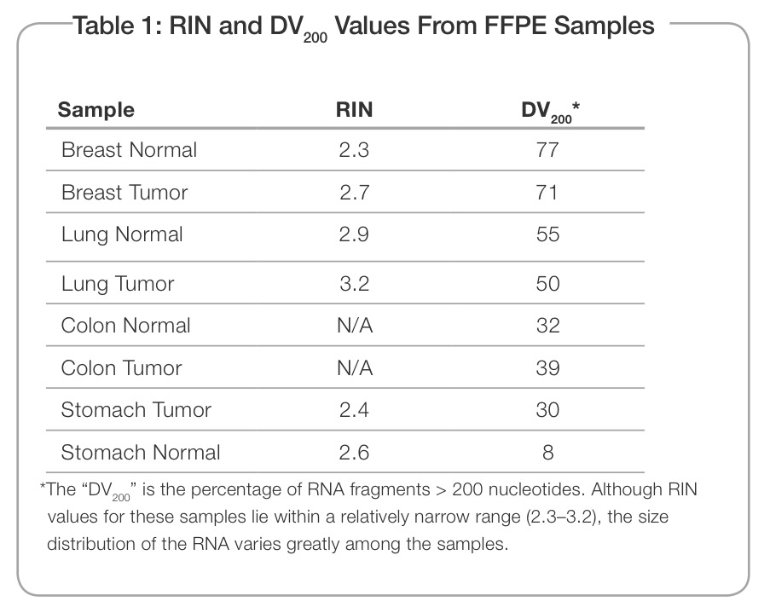
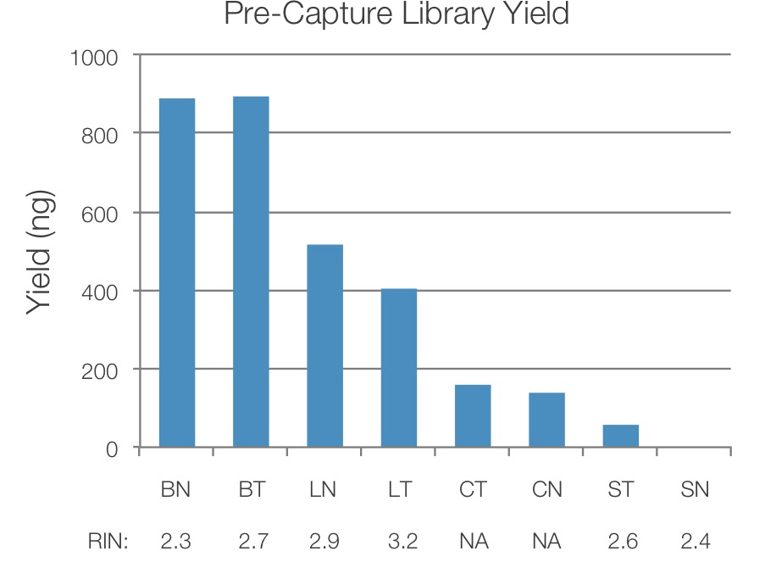
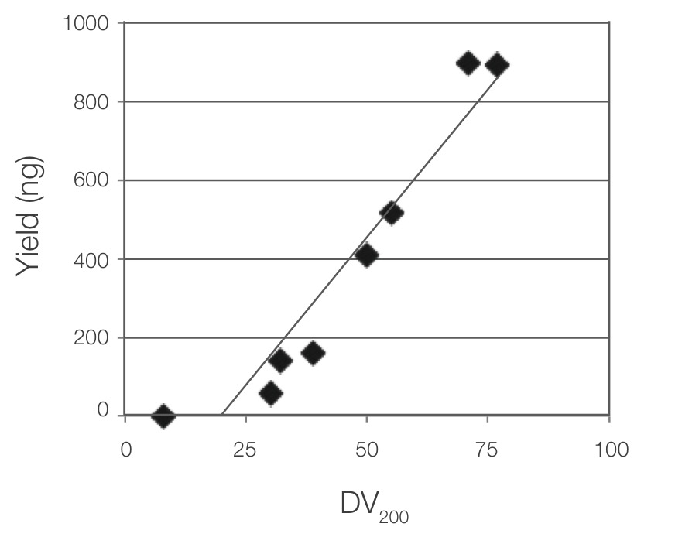
RNA Quality Considerations
DV₂₀₀ : Fraction of reads that are ~200 nt
RIN: RNA-Integrity number, using rRNA as proxy, used to determine the degree of RNA degradation
http://www.illumina.com/content/dam/illumina-marketing/documents/products/technotes/evaluating-rna-quality-from-ffpe-samples-technical-note-470-2014-001.pdf

Slide 5
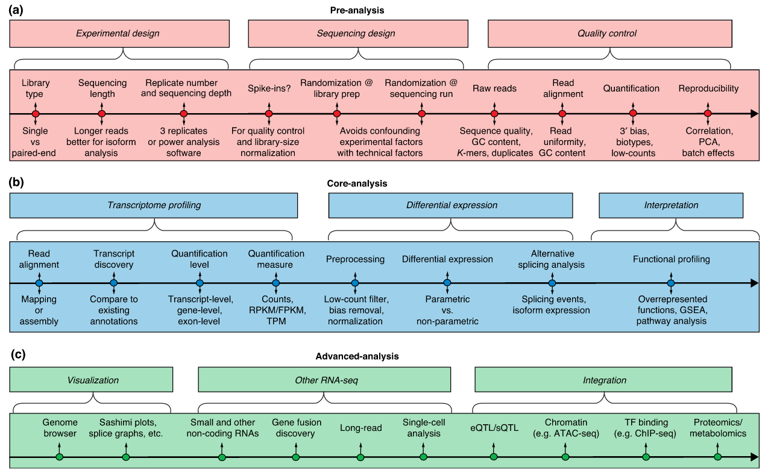
RNA-Seq start to finish:
https://www.ncbi.nlm.nih.gov/pmc/articles/PMC4728800/pdf/13059_2016_Article_881.pdf

Slide 6
First step: Library prep considerations:
Paired-end is default these days.
stranded or unstranded (stranded gives more information)
Longer reads are definitely better, if you are interested in mRNA. Shorter reads and single-end is sufficient for small RNA.
Sequencing Depth/Library size – depends on question saturation curves can be used to assess “completeness”
RNA extraction protocol:
Total RNA with rRNA depletion
Poly(A) pulldown
Targeted Sequencing

Slide 7
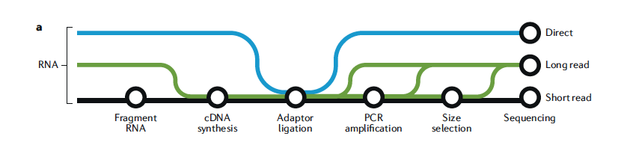
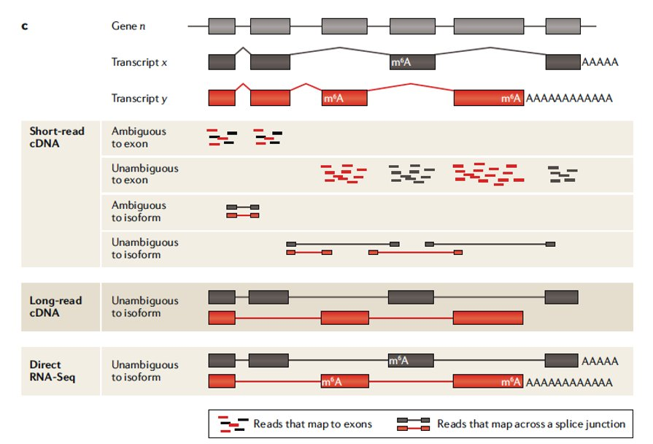
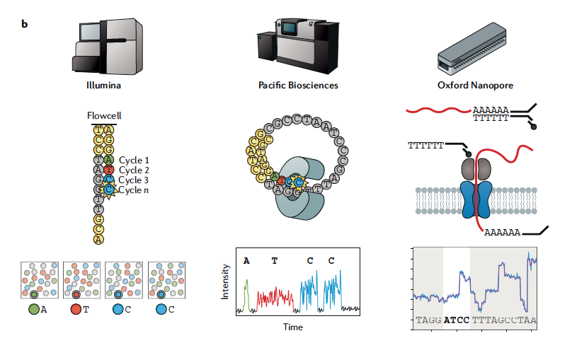
Types of sequencing
There are pros and cons to each approach

Slide 8
Library prep and sequencing
Library prep considerations
RNA capture methods:
Total RNA
polyA+ RNA?
Targeted/Captured
Ribo-reduction
Size selection -- Small RNAs vs. large RNAs?
Stranded vs. un-stranded libraries
Targeted/Captured?
Experimental Design, randomization
Avoid batch effects!

Slide 9
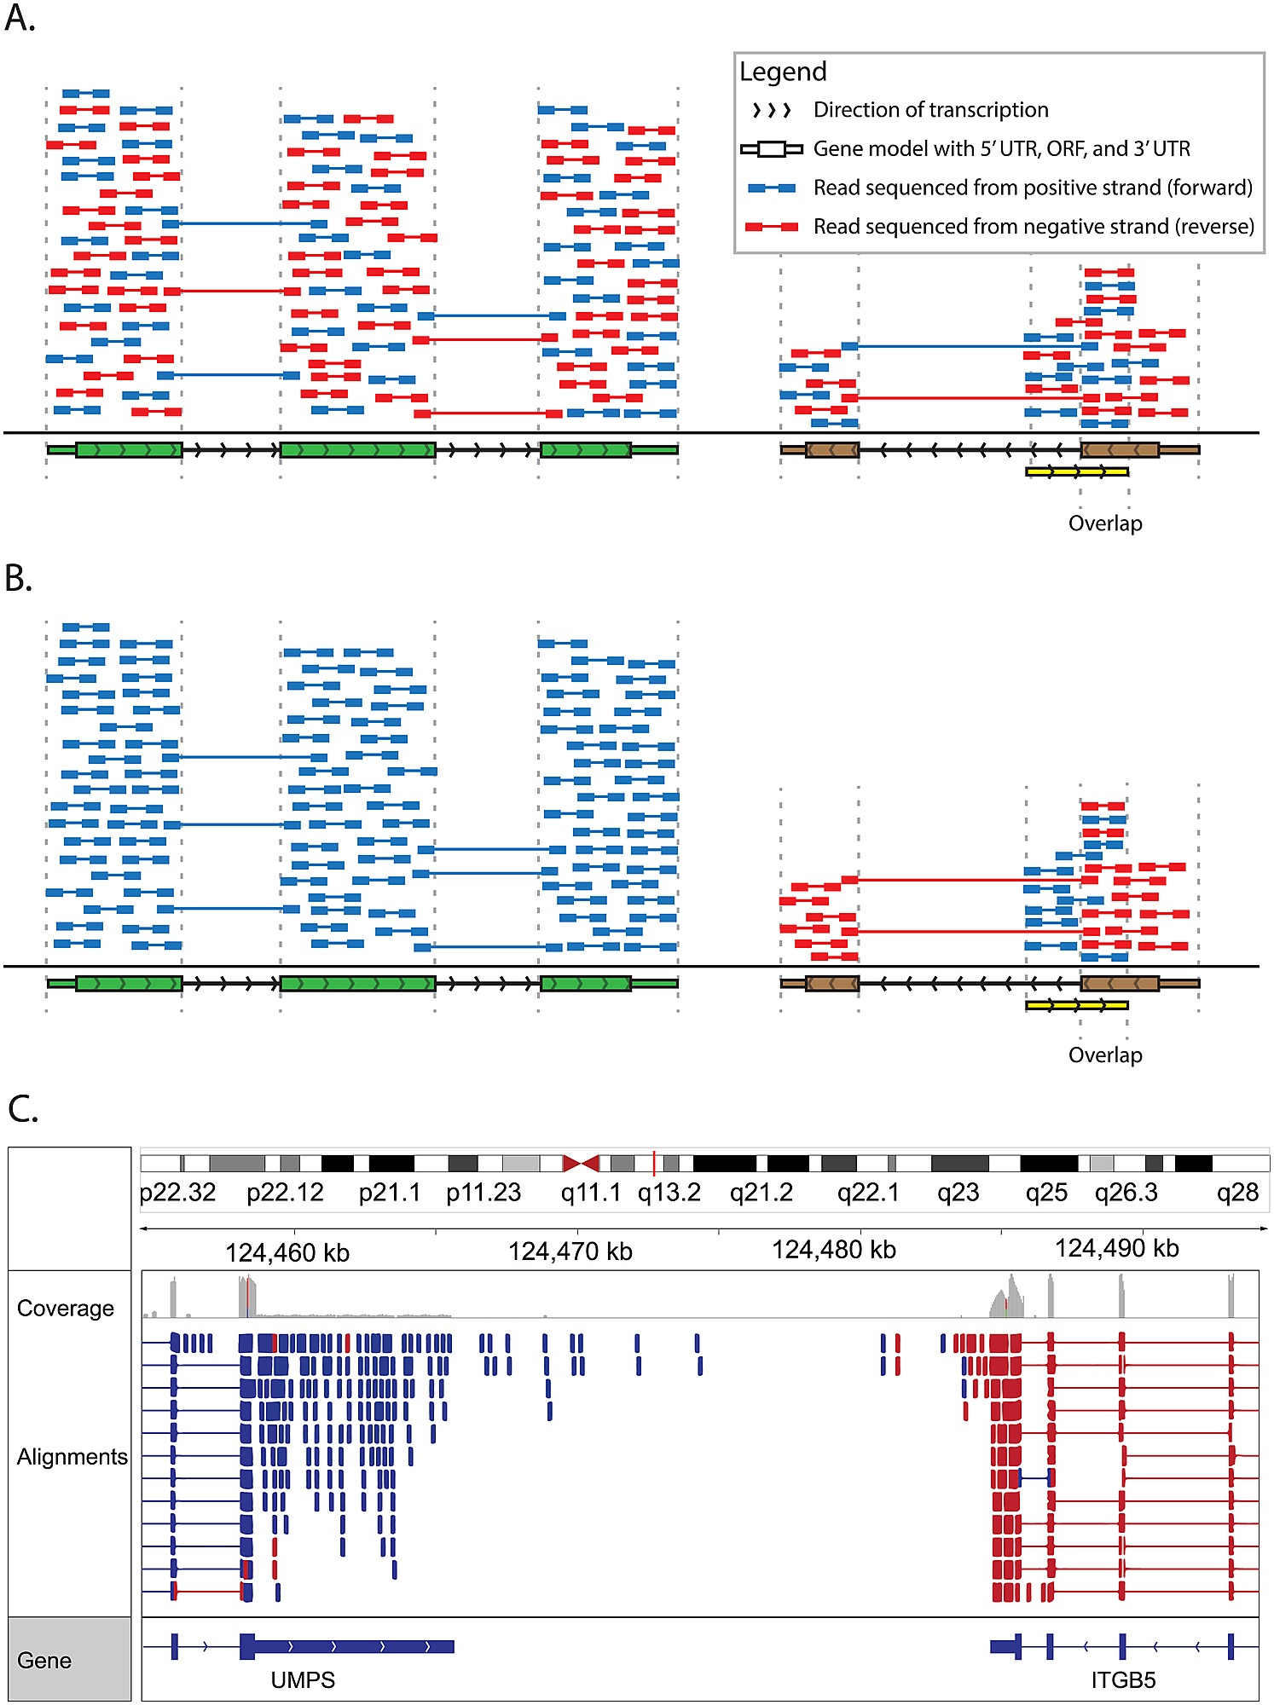
Library prep and sequencing
Approach depends on the biological question

Slide 10
Library QC
Most popular tools
It is important to assess the quality of your samples prior to further analysis.
Fastqc (for the quality of the reads)
http://www.bioinformatics.babraham.ac.uk/projects/fastqc/
Other tools (after alignment)
Qualimap - http://qualimap.bioinfo.cipf.es/
RSeQC - http://rseqc.sourceforge.net/
RNA-SeQC - http://archive.broadinstitute.org/cancer/cga/rna-seqc
Samtools -http://www.htslib.org/
Picard - https://broadinstitute.github.io/picard/

Slide 11
From reads to genes/transcripts
Typically map to genome or transcriptome
Consider mapping quality and percent mapped
Expect between 70-95% mapping
Lower % if using only transcriptome – unannotated transcripts lost
Pay attention to ‘location’ of mapped reads to transcript – 3’ bias (for poly(A) RNA)?
Duplication levels
rRNA levels
Most reads should map to exons

Slide 12
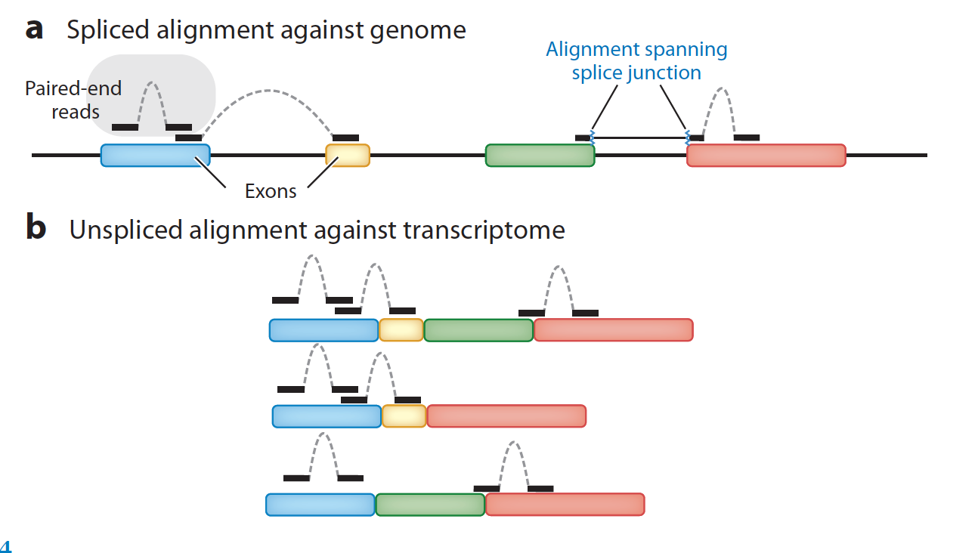
Alignment: Selecting a reference Genome
Choosing what to align to:
This step is critical as it will determine what is available for downstream analysis
Genome:
Both organism and exact version (hg18/hg19 etc.)
Read mapping not interchangeable (if you want a different genome you need to re-align).
Annotations:
Use latest stable release
Use a "trusted" source (Ensembl, UCSC)
Pick a version and stick with it
Aligner
Use splice aware aligner (STAR, tophat)

Slide 13
De-novo reconstruction
When ref genome is not available
A challenging problem
Many tools available
SOAPdenovo-TRANS - http://soap.genomics.org.cn/SOAPdenovo-Trans.html
Trans-ABySS - http://www.bcgsc.ca/platform/bioinfo/software/trans-abyss
Trinity - https://github.com/trinityrnaseq/trinityrnaseq/wiki
long-read technologies will make this easier
https://www.ncbi.nlm.nih.gov/pmc/articles/PMC4728800/pdf/13059_2016_Article_881.pdf

Slide 14
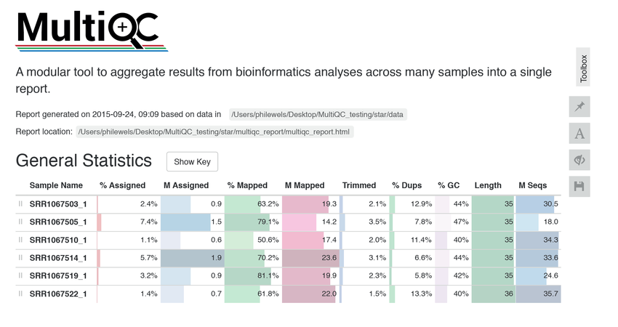
Post-alignment QC
COMMONLY USED TOOLS:
Samtools
Use 'samtools view' to see the format of a SAM/BAM alignment file
Use ‘FLAGs’ to filter out certain kinds of alignments
Use 'samtools flagstat' to get a basic summary of an alignment
RNA-SeQC
Most common QC metrics all in one place
Picard tools
Different sub-tools to calculate detailed QC metrics from alignments, to variants
MultiQC
Not a tool to measure QC but to collect all the data in an interactive report

Slide 15
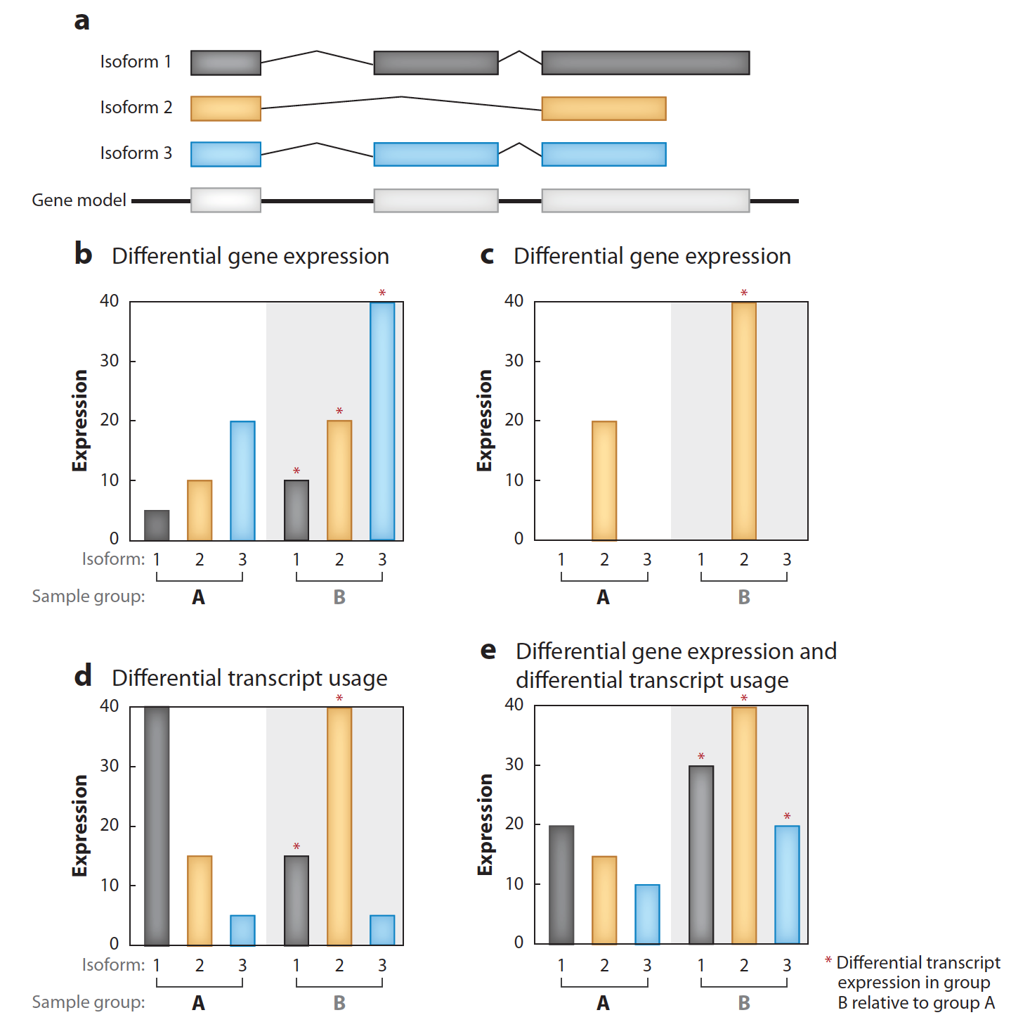
Gene/Transcript Quantification
Expression estimation for known genes and transcripts
‘FPKM’, ‘RPKM’, ’TPM’ expression estimates vs. ‘raw’ counts
"Normalized" methods are good for visualization
Most differential expression software use raw counts
Downstream interpretation of expression and differential estimates
multiple testing
Clustering
Heatmaps
Classification
pathway analysis
Dimensionality reduction

Slide 16
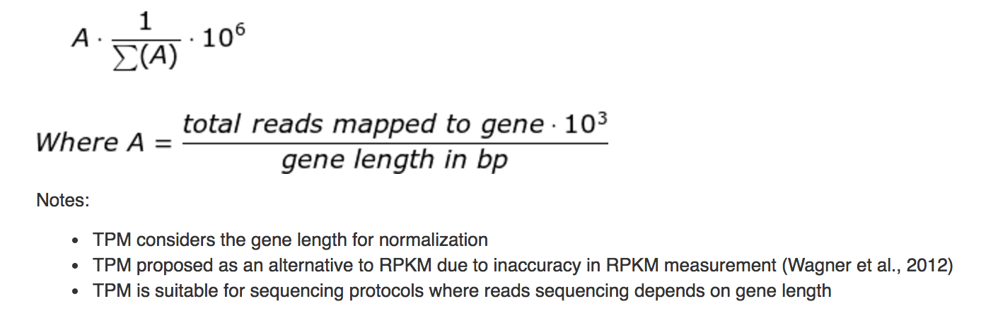
Counts? RPKM? FPKM? TPM?
"Raw" counts, expression is the # number of reads that map to a region.
Normalization is done based on library size, gene length is not considered.
RPKM – Reads per KB per Million
FPKM – Fragments per KB per Million
The only difference between RPKM and FPKM is that FPKM considers that two reads (in PE sequencing) can map to one fragment (so it doesn’t count this fragment twice).
TPM – Transcripts per Million
Considers gene length for normalization (longer genes will get more reads)
Proposed as a more stable way of measuring expression
TPM
RPKM (FPKM)

Slide 17
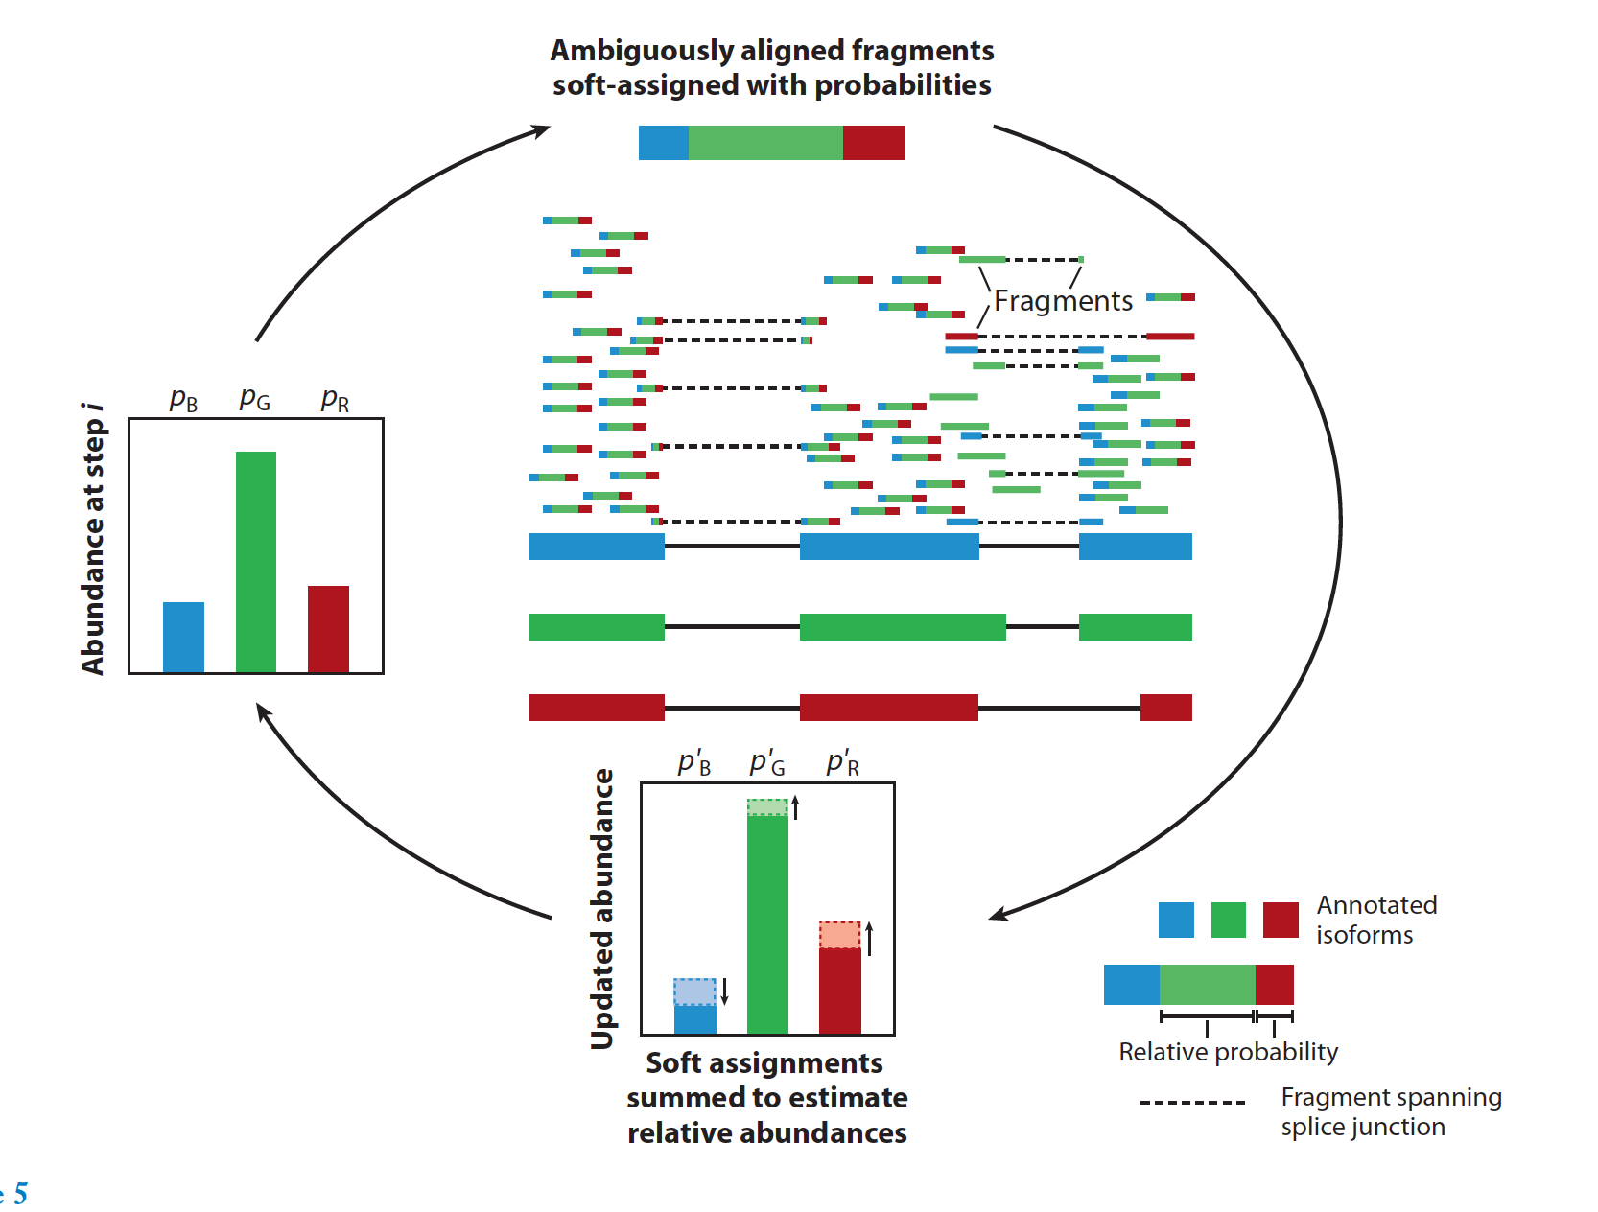
Isoform quantitation: EM-algorithm
Gene X has n number of reads mapping to it.
Gene X has isoforms A,B and C. For most reads we don't know which reads map to which isoforms.
The problem:
We need to know which reads are coming from which isoforms to calculate abundances
AND
We need to know the relative abundances of each isoform so we can calculate the probability of each read coming form an isoform.
TOOLS:
RSEM,
Kallisto,
Sailfish,
Salmon

Slide 18
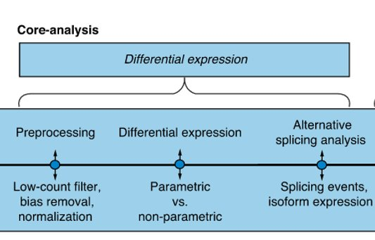
Differential Expression
Most common use of RNAseq data
Compare expression values between conditions to identify expression changes
Factors to consider
Batch effects, batch effects + confounding factors [tools COMBAT, SVA]
Depth of sequencing
Gene/Transcript length
Positional coverage bias
Fragment size
GC content
Batch effects
Batch effects
Batch effects

Slide 19
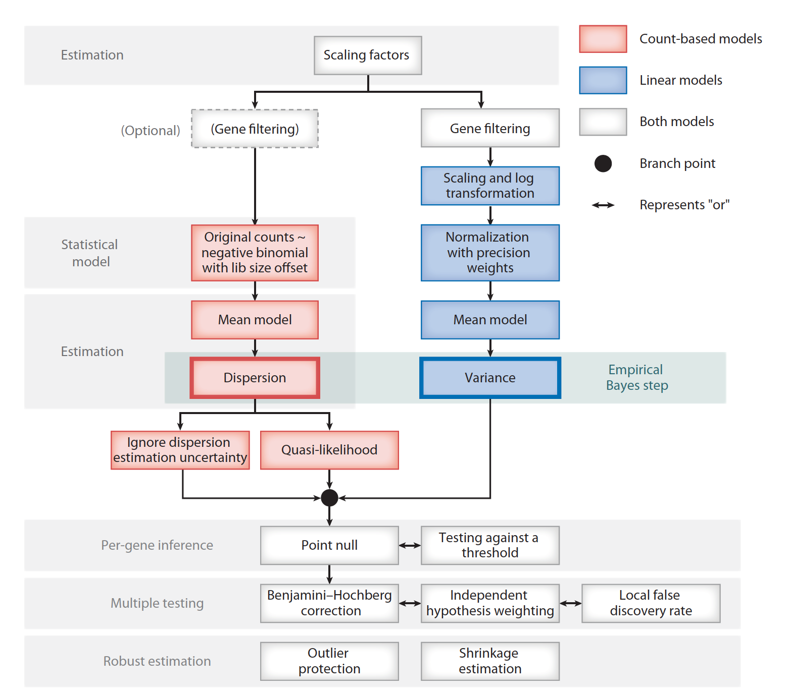
Differential Expression:
Number of replicates matters – pay special attention when few samples are available
Low expressed genes, usually hard to determine differential expression
Most Common tools
Limma – considered to be ‘good’ and very fast
DESeq2 and edgeR – similar performance.
DESeq2 is ‘conservative’ and edgeR is ‘liberal’ in FDR
SAMseq – good with lots of reps
NOISeq – good with differing number of reps. Undercalls
Cuffdiff – fairly poor, though most recognized – since it does it at the transcript level, which is difficult.
Important consideration is experimental design

Slide 20
Going beyond simple comparisons (advanced):
Sample name | Genotype | Drug | Time(h)
S1 | WT | PBS | 0
S2 | WT | PBS | 10
S3 | WT | PBS | 20
S4 | WT | Drug1 | 0
S5 | WT | Drug1 | 10
S6 | WT | Drug1 | 20
S7 | KO | PBS | 0
S10 | KO | PBS | 10
... | ... | ... | ...
Sn | KO | Drug3 | 20
We may be interested in several factors simultaneously (Genotype, treatment, time, dosage etc.).
We can model these interactions in our RNA-Seq data and ask sophisticated questions about each factor we are interested in and their interactions with one another.
~ genotype + drug + time + genotype:drug + drug:time
DESeq2, limma and edgeR support this kind of analysis.
As the number of variables increase the interpretation of the interactions between terms become more challenging. Use sparingly.
Interaction terms

Slide 21
Functional Profiling
What do you do with the identified ‘changes’?
Categorize them -- molecular functions and pathways
Compare DEGs to All Genes for over/under-represented gene sets
GSEA (gene set enrichment analysis) – ranking based on expression
Overlaps between different conditions
Length and other factors have to be considered
Annotations
GO, KEGG, Protein domains, WikiPathways etc.
TOOLS:
GOSeq
clusterProfiler
GSVA
fgsea
DAVID
And many more:
http://www.bioconductor.org/help/search/index.html?q=pathway

Slide 22
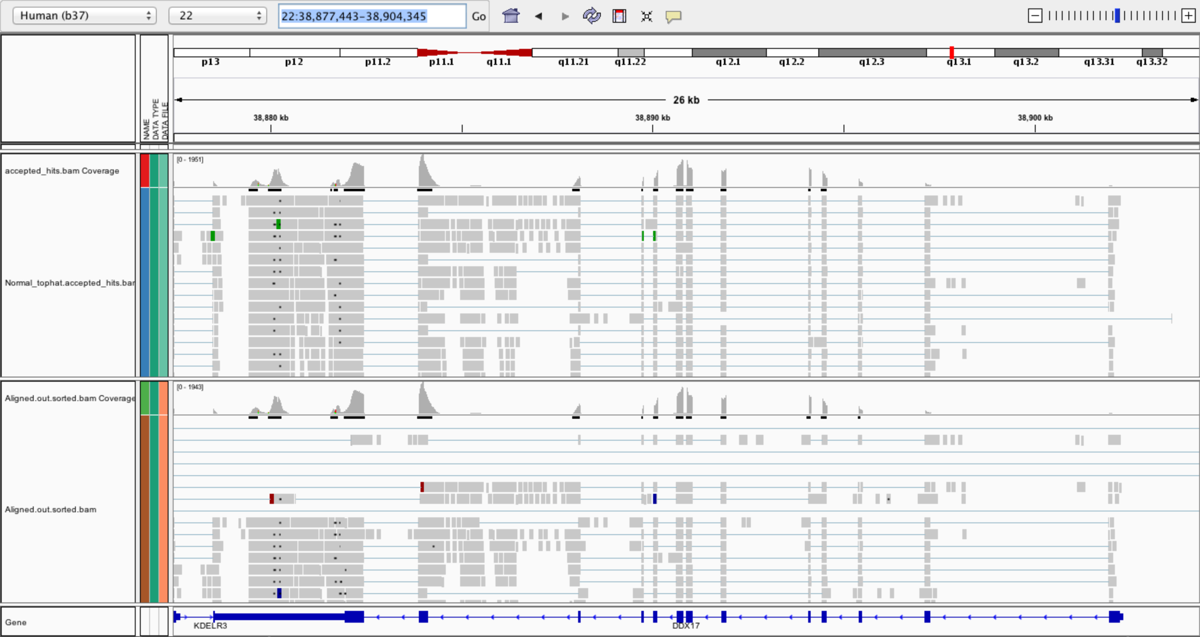
What to do Post-alignment
Create indexed versions of bam files
Use samtools/picard to do this (.bai)
These are needed by IGV for efficient loading of alignments
Visualize spliced alignments
Identify exon-exon junction supporting reads
Identify differentially expressed genes
Create a pileup from bam file
Determine read counts at a specific position
Genome Browser IGV

Slide 23
Splicing Analysis
Detecting changes in isoform levels is a fairly difficult task
Needs more (lots more) input data
150M reads to detect 80% of AS events
upwards of 400M reads for differential AS
Multiple isoforms and isoform reconstruction is not easy
Multi sample analysis is essential

Slide 24
Splicing Visualization (IGV,Miso)

Slide 25
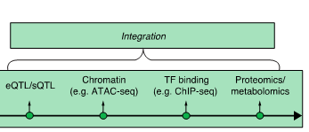
Multi-Omics Approach
RNA-Seq results can be combined with:
DNA-Seq, validating the impact of variants
eQTL: Expresion Quantitative Trait Locus
sQTL: Splicing Quantitiative Trait Locus
Chromatin accessibility, modification, validating the impact of DNA modifications, accessibility
ATAC-Seq
Bisulfite sequencing
Transcription Factor biding, does your protein of interest actual drive/inhibit transcription?
Proteomics, Just because you have RNA doesn't always mean you have protein.

Slide 26
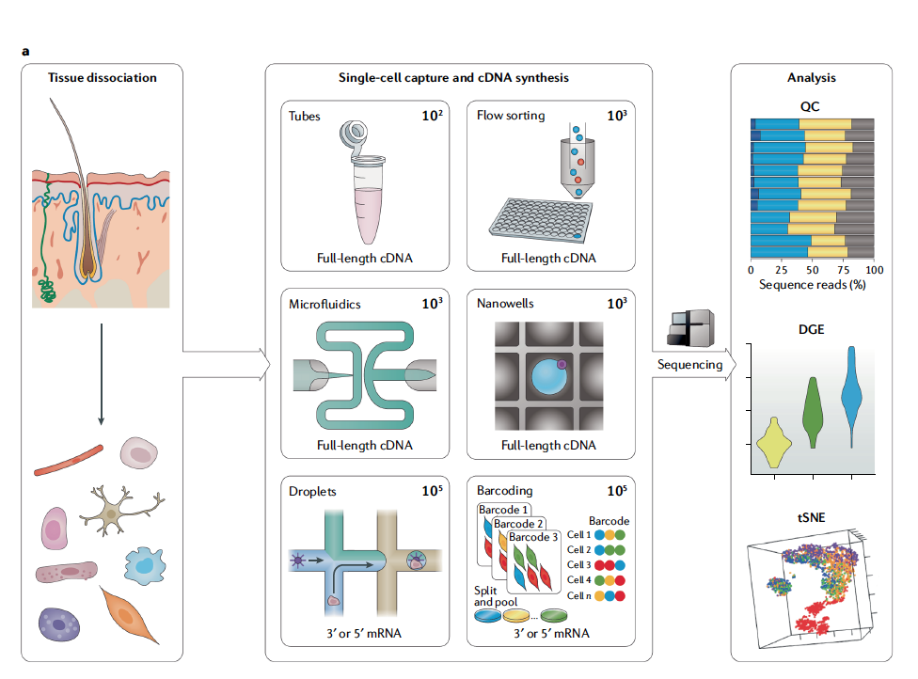
New(er) kids on the block: Single cell methods
scRNA-Seq
Tissues are dissociated into individual cells
Using microfluidics each cell is processed in a separate droplet (lysis, rna-extraction, library prep)
Each cell comes with a unique barcode so that individual expression levels can be calculated
Sequences using your favourite platform
Very useful for heterogenous samples (whole tissue, tumors, blood)
Current challenges:
Very computationally expensive
Categorization of cell types and sub-celltypes relies on high quality annoated data in literature
Very few reads/expression values per cell. Hard to tease out low expression, subtle changes

Slide 27
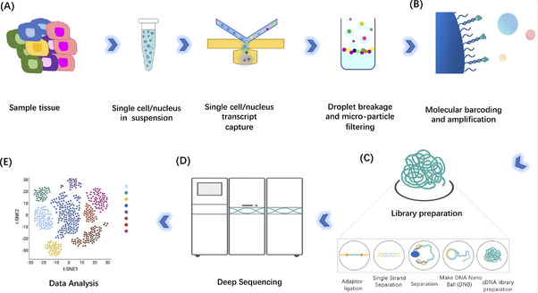
Process Overview:
Preparing single cell libraries is more involved than bulk RNA or DNA-Seq
Cells need to be separated w/o damaging them
Need to keep track each cell and which reads are coming from which cell
Computational methods are significantly more demanding

Slide 28
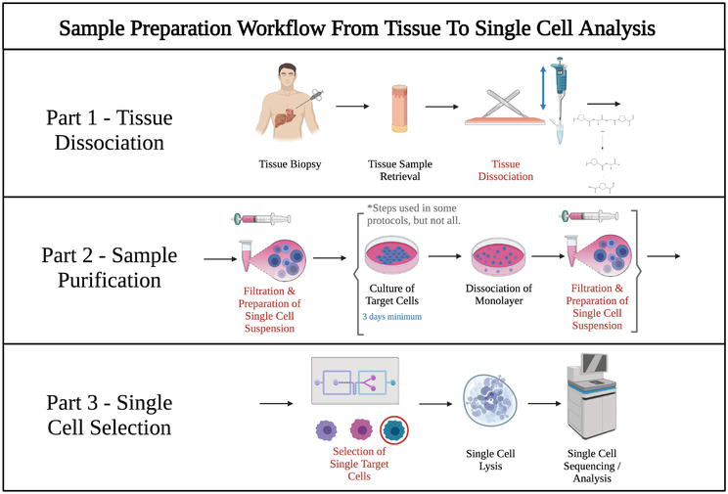
Sample Preparation: Processing tissues
Depends on the tissue of interest
Cells need to separated individually w/o affecting the transcriptome (stress induced changes)
Some tissues (e.g. brain, muscle) is especially difficult to dissociate
Single nucleus RNA-Seq (SnRNA-seq) can be used to overcome this challenge
SnRNA-seq however generates less RNA and only captures genes that are being actively transcribed

Slide 29
Data Analysis: File types and tools
Hdf5:
Developed by National Center for Supercomputing Applications
Designed to be hierarchical can contain datasets/"folders"
Is essentially a matrix storage
Fast (much faster than tsv) loading
Loom
Based on hdf5 but single "folder"
A stack of matrices share column and row annotations
Mtx
Designed to store sparse (most of the cells are 0) matrices
Lower storage and memory requirements
Bcl
Individual images taken by the sequencer
Not useful for data analysis as is, needs to be converted to fastq
R: rhdf5
Python: h5py
R: loomR
Python: loompy
R: Matrix (also comes with highly optimized sparse matrix operations)
Python: scipy.io.mmread
bcl2fastq (probably will never use it)

Slide 30
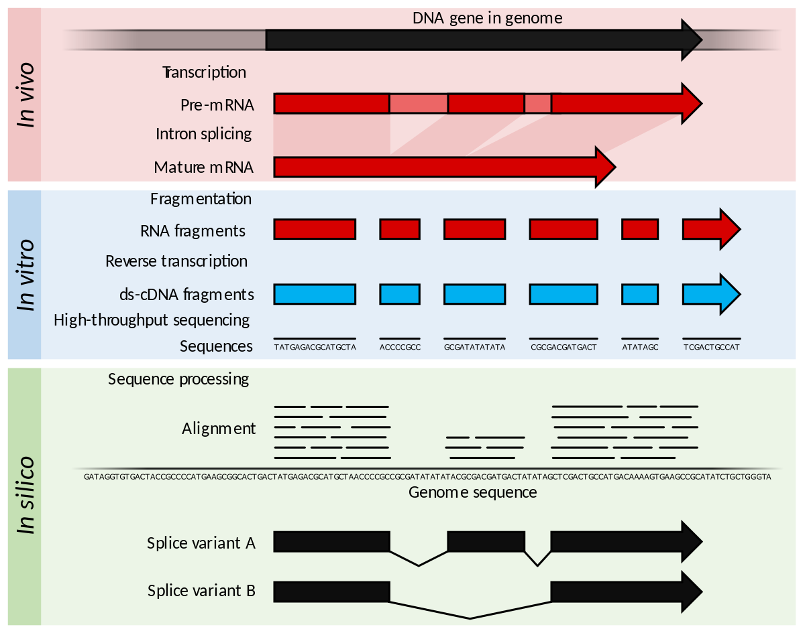
Data Analysis: Preprocess/Alignment
Some of the steps are similar to bulk RNA-Seq
Read quality using fastqc
Alignment metrics using picard or similar tools
Accessing/filtering bam files using samtools etc.
In addition to the actual reads scRNA-Seq samples may also contain an "index" read these are the barcodes used and each barcode corresponds to a single cell (or a location if spatial transcriptomics)
Genome index generation
STAR: Similar to bulk rna-seq
CellRanger pre-filtering of GTF files
Kalisto, salmon for fast processing
For alignment:
STAR single cell specific commands
CellRanger (uses star at the backend with some bells and whistles)
Kalisto, salmon for fast processing
Viewing filtering barcodes/umis
UMI-tools

Slide 31

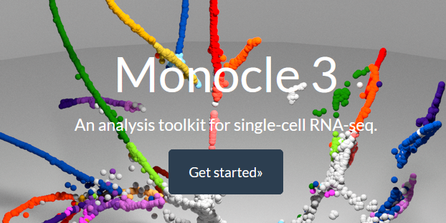

Data Analysis: workflow packages
Seurat (R):
Very popular easy to use
A lot of built in functions for general operations
Integration, cell type identification, visualization works pretty well out of the box
Does not do pseudotime analysis
Only for RNA-Seq (Signac for ATAC-Seq)
Monocle3 (R):
Also very popular
Slightly different interface
Pseudotime analysis possible
SingleCellExperiment (R):
A base package for holding single cell data
More of a container than a workflow package
Scanpy (python):
Most popular python package for single cell (also ATAC-Seq with additional packages)
Has similar functionalities to seurat and monocle
Easy to use, methods work well out of the box
Excellent ecosystem for other types of analyses
Notes:
Add tools how to do each of the

Slide 32

Data Analysis: QC
Before analysis we need to remove cells that are not suitable for analysis
Droplets with no cells
Built in functions from Seurat, monocle, scanpy
These have very few reads mapping to genes
Low quality cells
High # of mitochondrial genes
Doublets (multiple cells per drop or dividing cells)
Very high # of reads mapping
Scrublet (python package)
Demuxlet (shell)
Scater for basic QC metrics
Notes:
Add tools how to do each of the

Slide 33
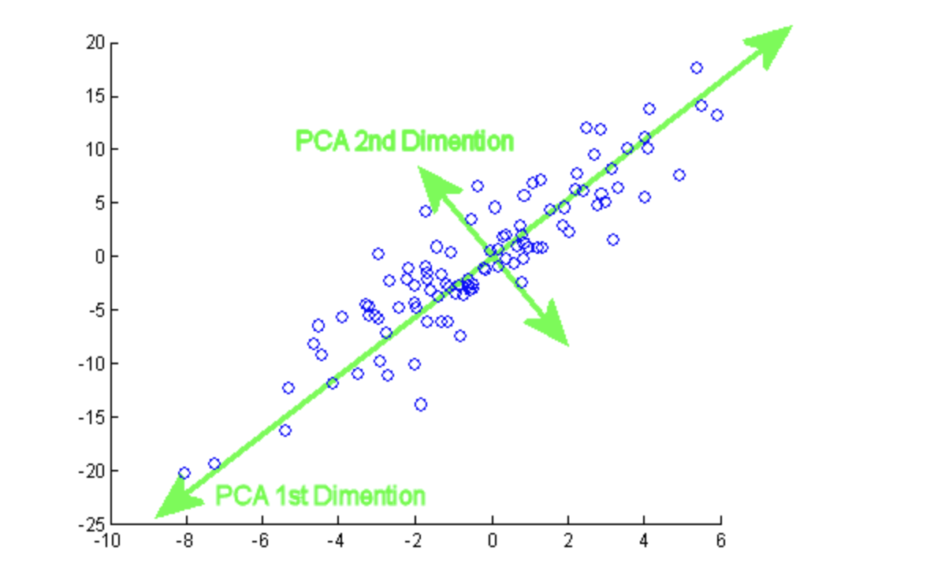
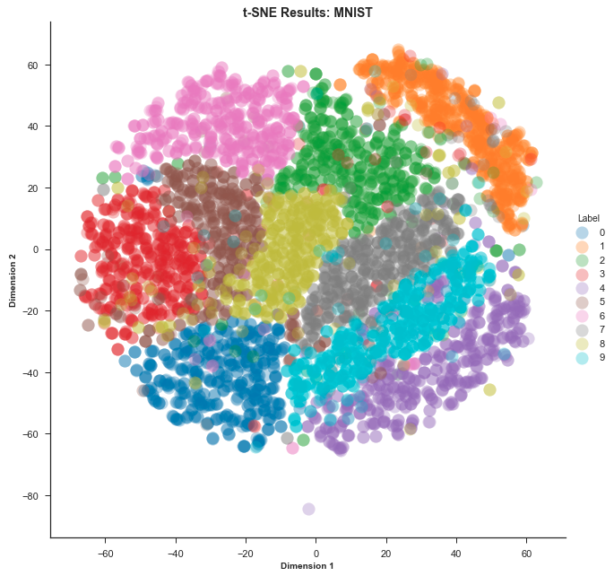
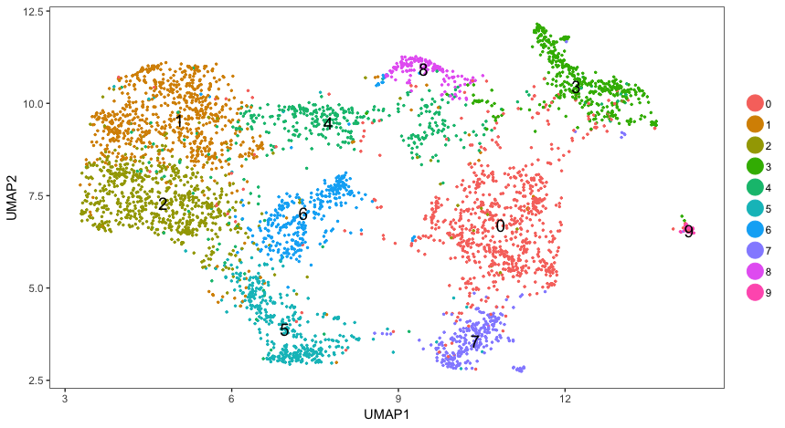
Data Analysis: dimensionality reduction
Usually an scRNA-Seq dataset has very high dimensionality
However, most of the values are 0
We can reduce the dimensions of our dataset to make it more amenable to analysis
We can find the most variable features in our data and use those (a gene gets 0 or almost 0 reads in our dataset it is not very interesting)
There are 3 most common methods:
PCA (principal component analysis)
tSNE (t-distibuted stochastic neighbor embedding)
UMAP (uniform manifold approximation projection)
All the workflow packages have built in functions to perform these reductions
Notes:
Pca, umap tsne

Slide 34
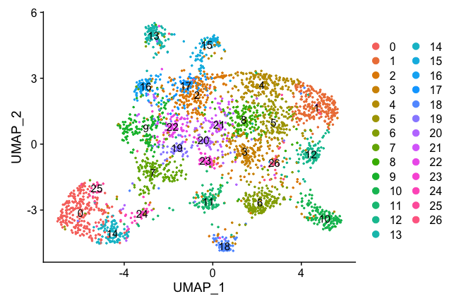
Data Analysis: Clustering
There are many methods some more computationally intensive than others
Clusters are calculated using the reduced dimensions
Seurat, monocle3 and scanpy have built in clustering methods
Most common algorithms louvain and leiden, you can also use k-means but not as popular. There are hyperparameters to optimize
You can over cluster
You can visualize how cells and clusters change with different parameters using clustree R package
You should have a rough idea about the # of clusters (usually corresponds different cell types) you are going to get from your samples
if you are expecting 10 cell types and you got 97 clusters something is not right
Notes:
Clustering algorithms
Especially louvain, leiden

Slide 35
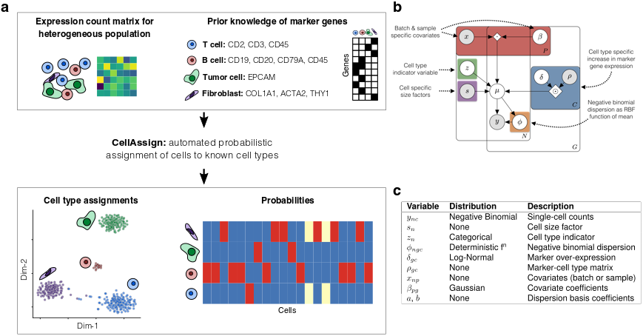
Data Analysis: Cell type identification, using marker genes
Expert knowledge is the best resource
If you have markers for your cell types
You can visualize expression of markers in each cluster
Assign cell type to that cluster(s)
There are packages that allows you to speed up the process
Garnett, You can also use pre-trained models out of the box
Seurat FindMarkers (doesn’t always work)
Scanpy MarkerGenes
You can get markers for your genes by browsing repositories and atlases (i.e. human cell atlas)
There are other packages that uses known gene expression levels
SingleR
ScCATCH
cellassign
Notes:
Seurat, garnet, scpred, scANVI many others
Cell databases

Slide 36
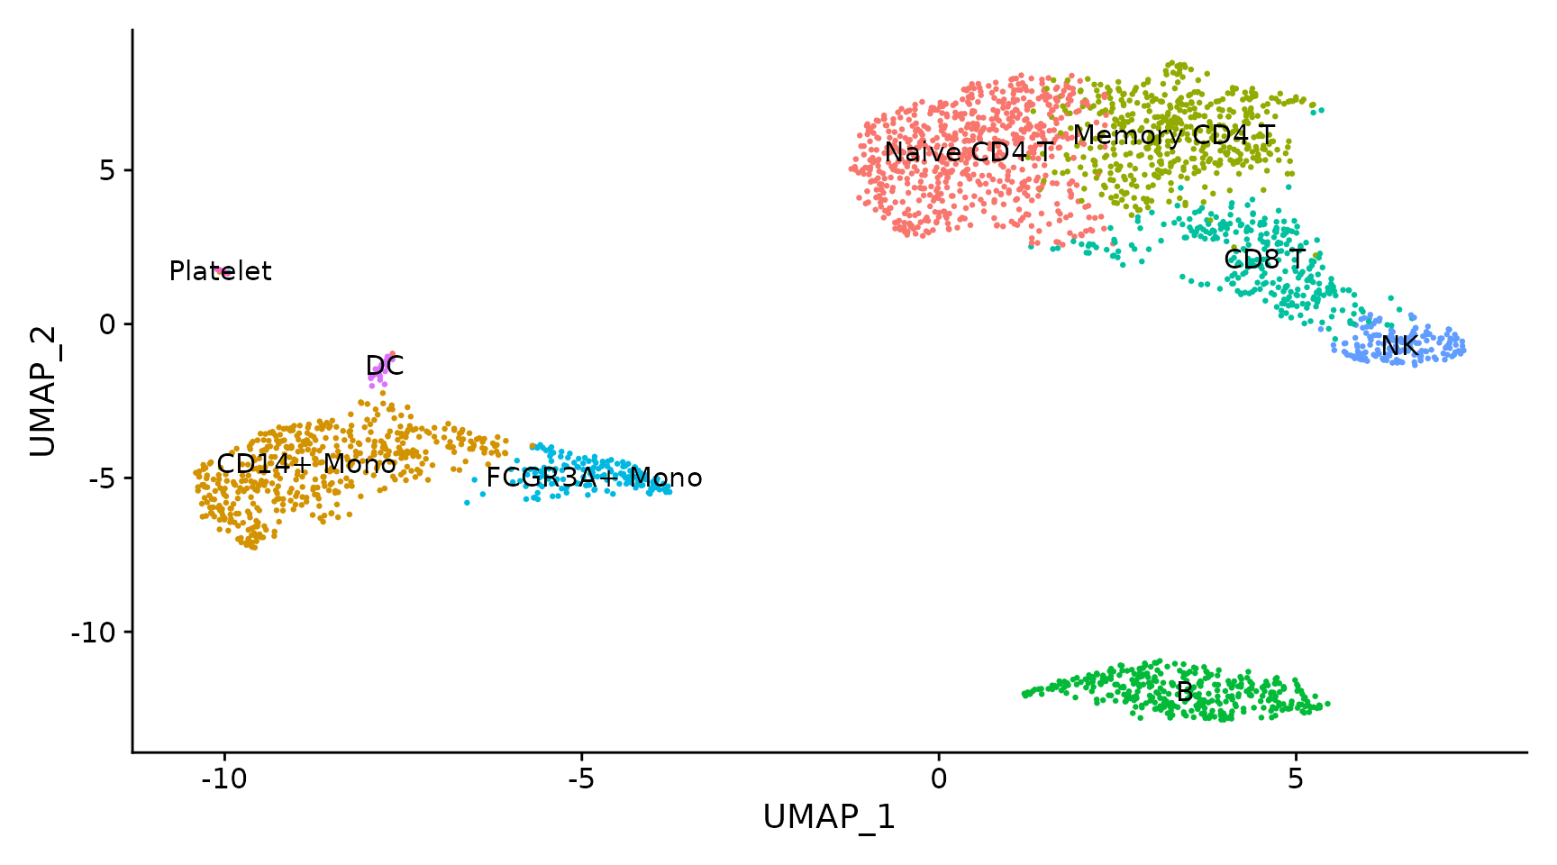
Data Analysis: Cell type identification, using ml models
Sometimes a single marker is not available
You need to look at the overall expression levels
You can train ML models and assign cell types based on model predictions
You need expert labelled data to train the model
Statistical leakage and overfitting is always a concern
You may have cells in your data that is not present in the training data
Your cell composition might be very different from the training data
Some packages:
scPred (R) based on caret very flexible
CHETAH (R)
scANVI (python)
Seurat and Monocle also have integration methods that can take a labelled object and project the labels on the unlabeled data
Notes:
Seurat, garnet, scpred, scANVI many others
Cell databases

Slide 37
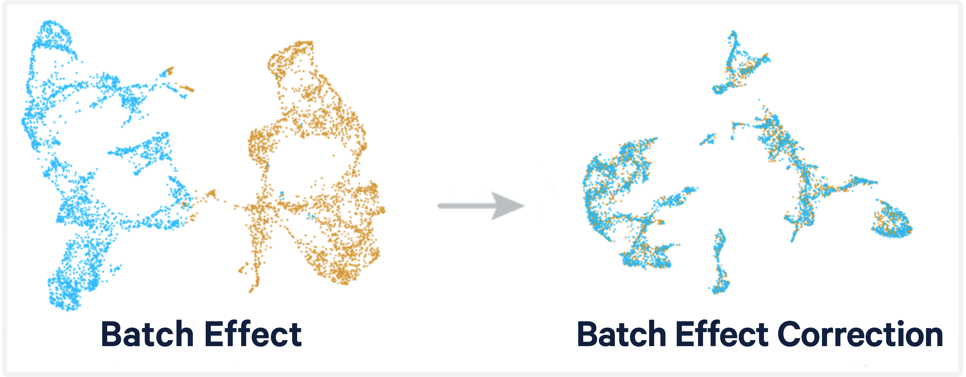
Data Analysis: Integrating multiple samples
Where there are more than one samples, we need to combine them to be able to analyze them together
If there are significant batch effects or different technologies were used, we need to remove these effects
Seurat, monocle3 and scanpy have built in functions to perform this task
It's best to avoid batch effects, correction methods can be aggressive and remove biological differences
Also available for data integration:
Harmony (R)
Scmap (R)
Monet (python)
Data integration can also be used for cell type identification by combining an already labelled dataset onto an un-labelled one
Batch effects can be removed by:
"regressing out" known variables
Liger (R)
Batchelor (R)
Notes:
Seurat, scanpy, sva, harmony

Slide 38
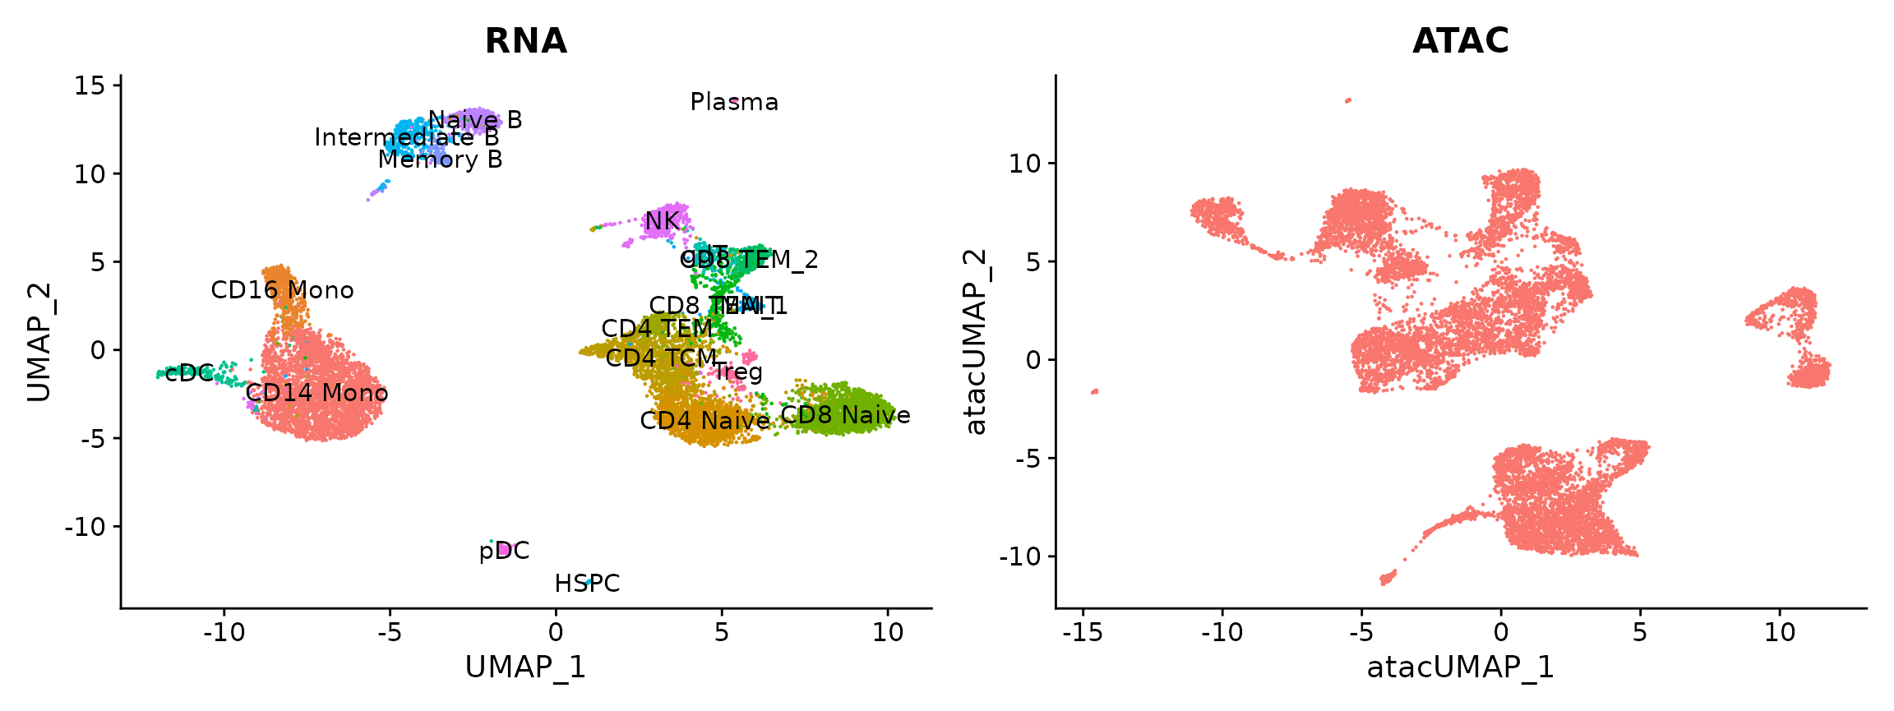
Data Analysis: Integrating multi-omic data
It is also possible to integrate different modalities like RNA and ATAC seq datasets
Seurat and scanpy can do this out of the box but may not work well
Seurat uses that total accessibility of a genomic region as a proxy for RNA expression this may or may not hold true
There are several other packages some work better than others
Depending on your needs and dataset you might need to try multiple packages/scripts to get acceptable results
After integration you can use your RNA labels to label your ATAC seq data
Not sure about how this integration works with other modalities like bisulfite sequencing
If possible, opt for multi-omics analysis on the same sample

Slide 39
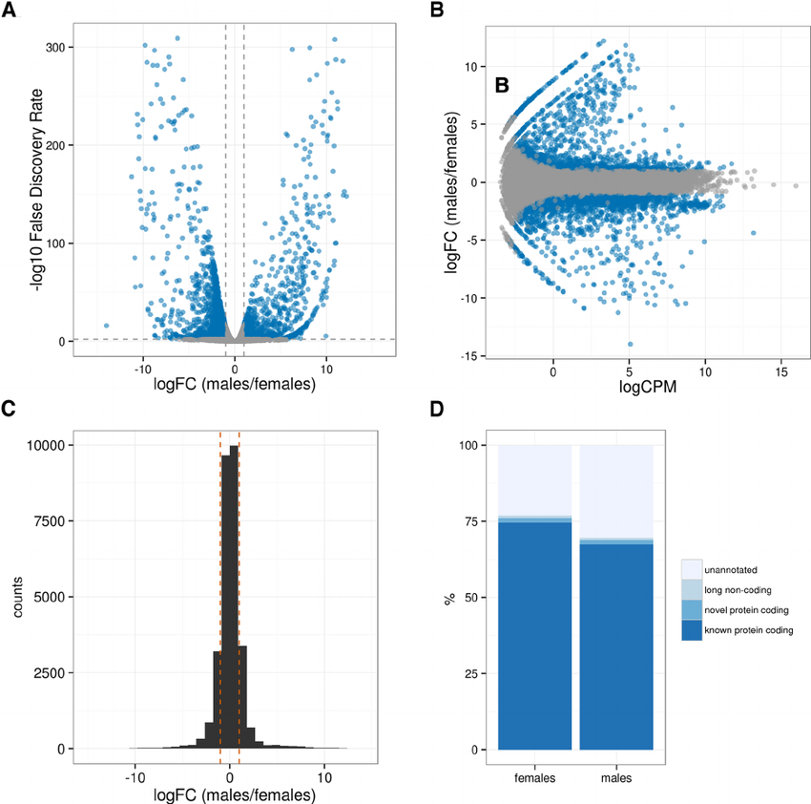
Data Analysis: Differential expression
Differential expression analysis is significantly different than bulk RNA-Seq
Data is 0 inflated and sparse
Pseudo replication is an important issue
There are several packages
MAST
DESeq2 (with different settings see vignette)
Zinbwave (0 inflated modelling)
Diffxpy
And many more
You will need more than one sample (preferably 3-4 per condition) to perform differential expression
Hard to compare nuclear and cytoplasmic RNA-Seq datasets avoid making strong conclusions
Different packages make different decisions results will be similar but identical
Downstream steps (enrichment analysis etc.) are identical to bulk rna-seq

Slide 40
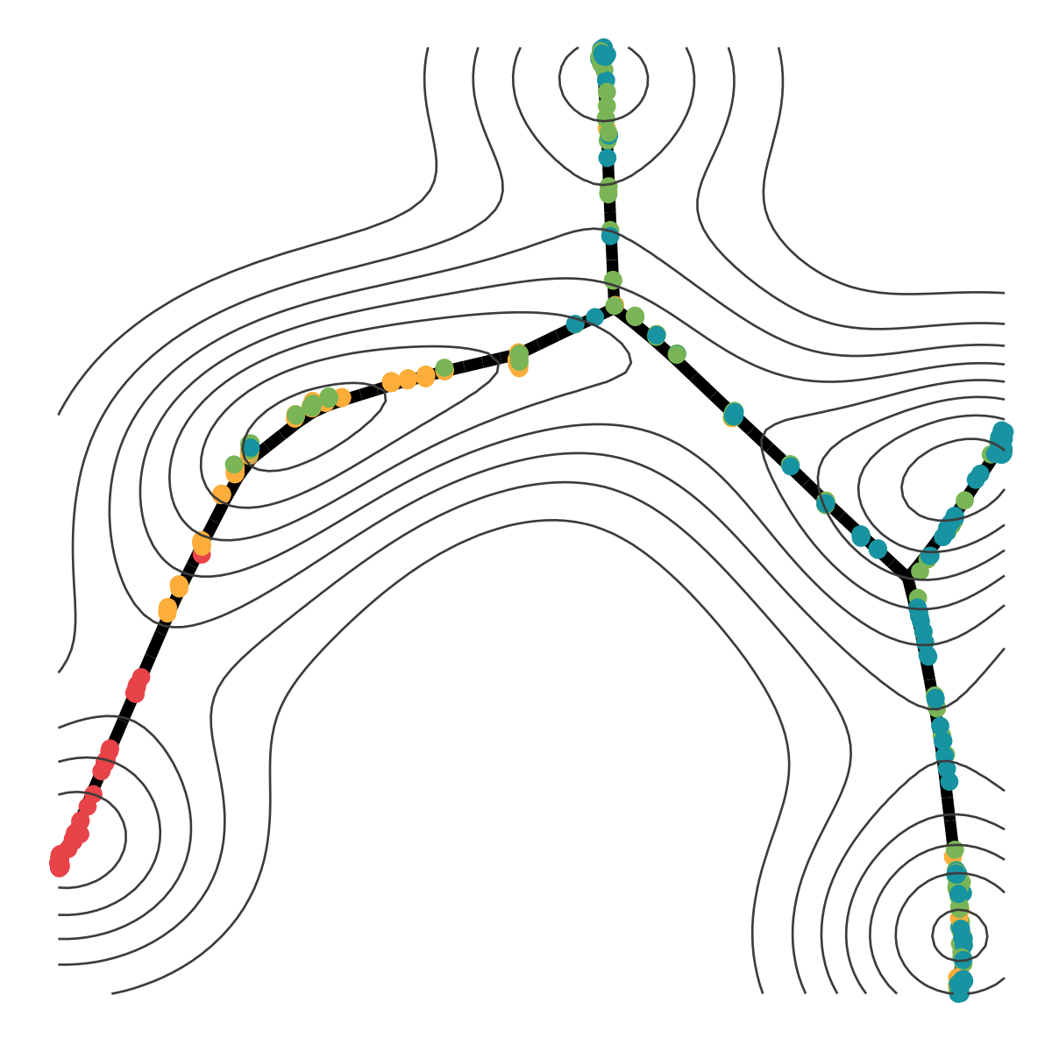
Data Analysis: Pseudotime
In bulk RNA-Seq we assume that the cells are in the same state uniformly within the tissue
With single cell methods we can investigate this assumption
Pseudotime analysis refers to a latent (unobserved) dimension which measures the cells' progress through the transition.
We can see transition to and from different states because (hopefully) we have intermediate cells in our dataset.
We can model this transition (and branching)
Because pseudotime is not time we need to tell the computer where the origin is.
Different cell types will have different "origins"
Some popular packages:
Monocle3
SCVelo
Slingshot
VELOCYTO

Slide 41
Tool recommendations
Alignment
STAR (PMID: 23104886), Tophat (PMID: 19289445), MapSplice (PMID: 20802226), GSNAP,
Spliced alignment to genome
Expression, differential expression alternative expression
DESEq2, EdgeR, Cufflinks/Cuffdiff (PMID: 20436464)
Fusion detection
Defuse (PMID: 21625565), INTEGRATE (PMID: 26556708), EricScript (PMID: 23093608), FusionMap (PMID: 21593131)
Transcript assembly
Trinity (PMID: 21572440), Oases (PMID: 22368243), Trans-ABySS (PMID: 20935650)
Variant Calling
GATK pipeline + Filtration scripts
Splicing
VastTools, MISO, JunctionSeq, Many others!
Visit the ‘SeqAnswers’ or ‘BioStar’ forums for more recommendations and discussion
http://seqanswers.com/
http://www.biostars.org/
Notes:
To find the papers above using their PMID, go to PubMed and enter the ID in the search box
http://www.ncbi.nlm.nih.gov/pubmed

Slide 42
Useful resources bulk rna-seq:
Web resources
DeSeq2 tutorial: http://bioconductor.org/packages/devel/bioc/vignettes/DESeq2/inst/doc/DESeq2.html
clusterProfiler detailed vignette: https://yulab-smu.top/biomedical-knowledge-mining-book/index.html
Ensembl/Biomart: ensembl.org
UCSC genome browser: https://genome.ucsc.edu/
BioStars
Stackoverflow (for general programming questions)
R Packages
GenomicFeatures (and its dependencies)
AnnotationDbi
Org.Dbi/TxDb

Slide 43
Useful resources single cell:
Seurat documentation:
https://satijalab.org/seurat/index.html
Monocle3 documentation:
https://cole-trapnell-lab.github.io/monocle3/
Scanpy documentation:
https://scanpy.readthedocs.io/en/stable/
Lists of software packages for single cell analysis:
https://github.com/seandavi/awesome-single-cell
https://www.scrna-tools.org/
For programming:
StackOveflow
For biology related questions
Biostars
Toronto scAnalysis Working Group
sctoronto.slack.com
Human cell atlas:
https://www.humancellatlas.org/
Allen Brain atlas:
https://portal.brain-map.org/
Descartes single cell atlas
https://descartes.brotmanbaty.org/
CD marker handbook human and mouse:
https://www.google.com/url?sa=t&rct=j&q=&esrc=s&source=web&cd=&ved=2ahUKEwi629Kbn8f7AhVxk4kEHdvHDLUQFnoECAwQAQ&url=https%3A%2F%2Fwww.bd.com%2Fdocuments%2Fbd-legacy%2Fcatalogue%2Fbiosciences%2FDS_Human-Mouse-CD-Maker-Biosciences_CT_DE.pdf&usg=AOvVaw2nwMOakYW0W2bpFOjfIrDb

Slide 44
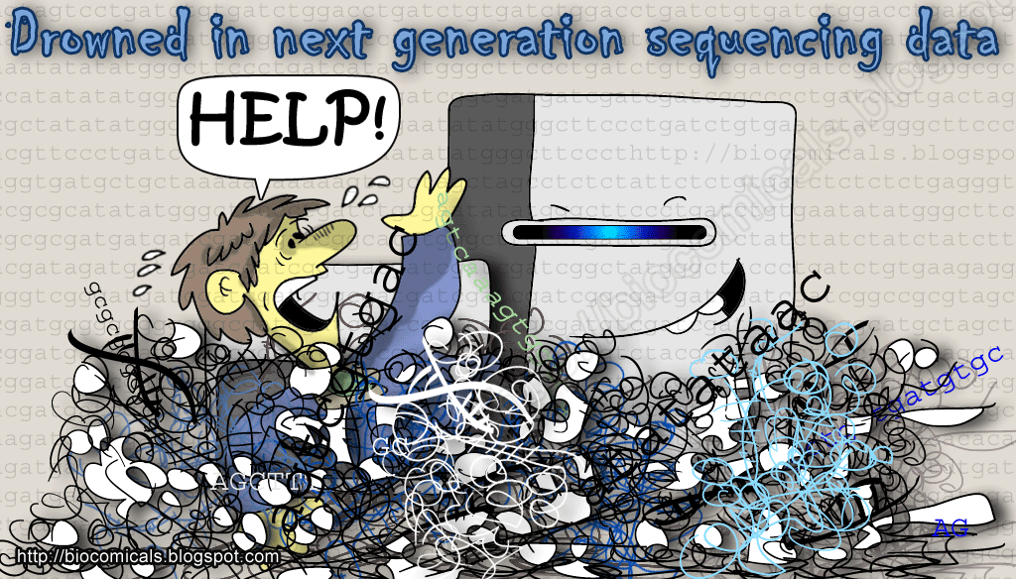

Slide 45
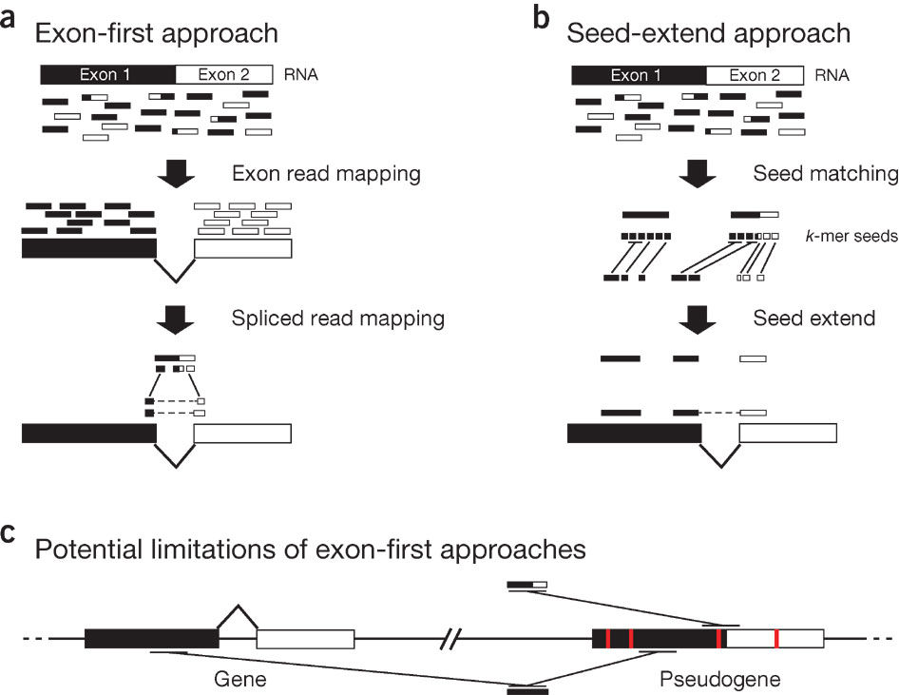
Alignment with STAR
Advantages of STAR
very fast!
quite accurate
de-novo detection of splice junctions
any length of sequence
auto trims poor quality reads
also useful in finding chimeric reads
RAM, lots and lots of it. ~30gb for a hg/mm
Alignment Steps (applies to most aligners)
Genome Index: Dictionary/Appendix for a quick search of a sequence (“page”)
pre-built for each genome
use fasta sequences
Optionally add transcriptome to Index
gene transfer format (gtf) file
Align to Indexed genome
Results in a bunch of files
sam/bam file
mapping statistics
splice junction file

Slide 46
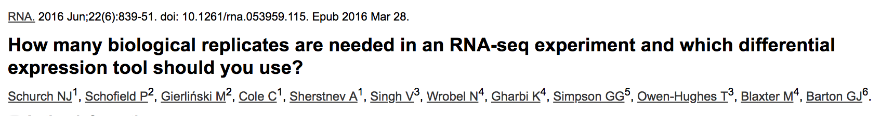
Number of Replicates?
Difficult Question to answer.
Variability is an important consideration--- Depends on the number of steps in prep and care taken
Cost!
Sample availability
Technical vs Biological
The underlying biological question
http://scotty.genetics.utah.edu/help.html
If similar experiment is available, use as guide!

Slide 47
Depth of Sequencing
Depends on several factors:
Question being asked of the data. Gene expression? Alternative expression? Variant calling?, Splicing?
Tissue type, RNA preparation, quality of input RNA, library construction method, etc.
Sequencing type: read length, paired vs. unpaired, etc.
Computational approach and resources
Identify publications with similar goals
Pilot experiment
Use Scotty:
http://scotty.genetics.utah.edu/

Slide 48
Splicing Analysis Performance

Slide 49
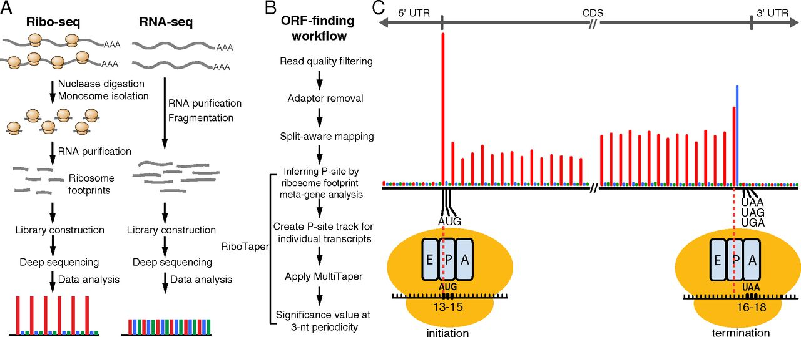
Ribosome footprint profiling
Purified monosomes are digested by a nuclease
Fragments protected by the ribosome are isolated
Library preparation/sequencing along with regular RNA-Seq
We can determine the location of ribosomes on mRNAs and gain insight into translation dynamics
Can also be used to discover novel ORFs or uORFs

Slide 50
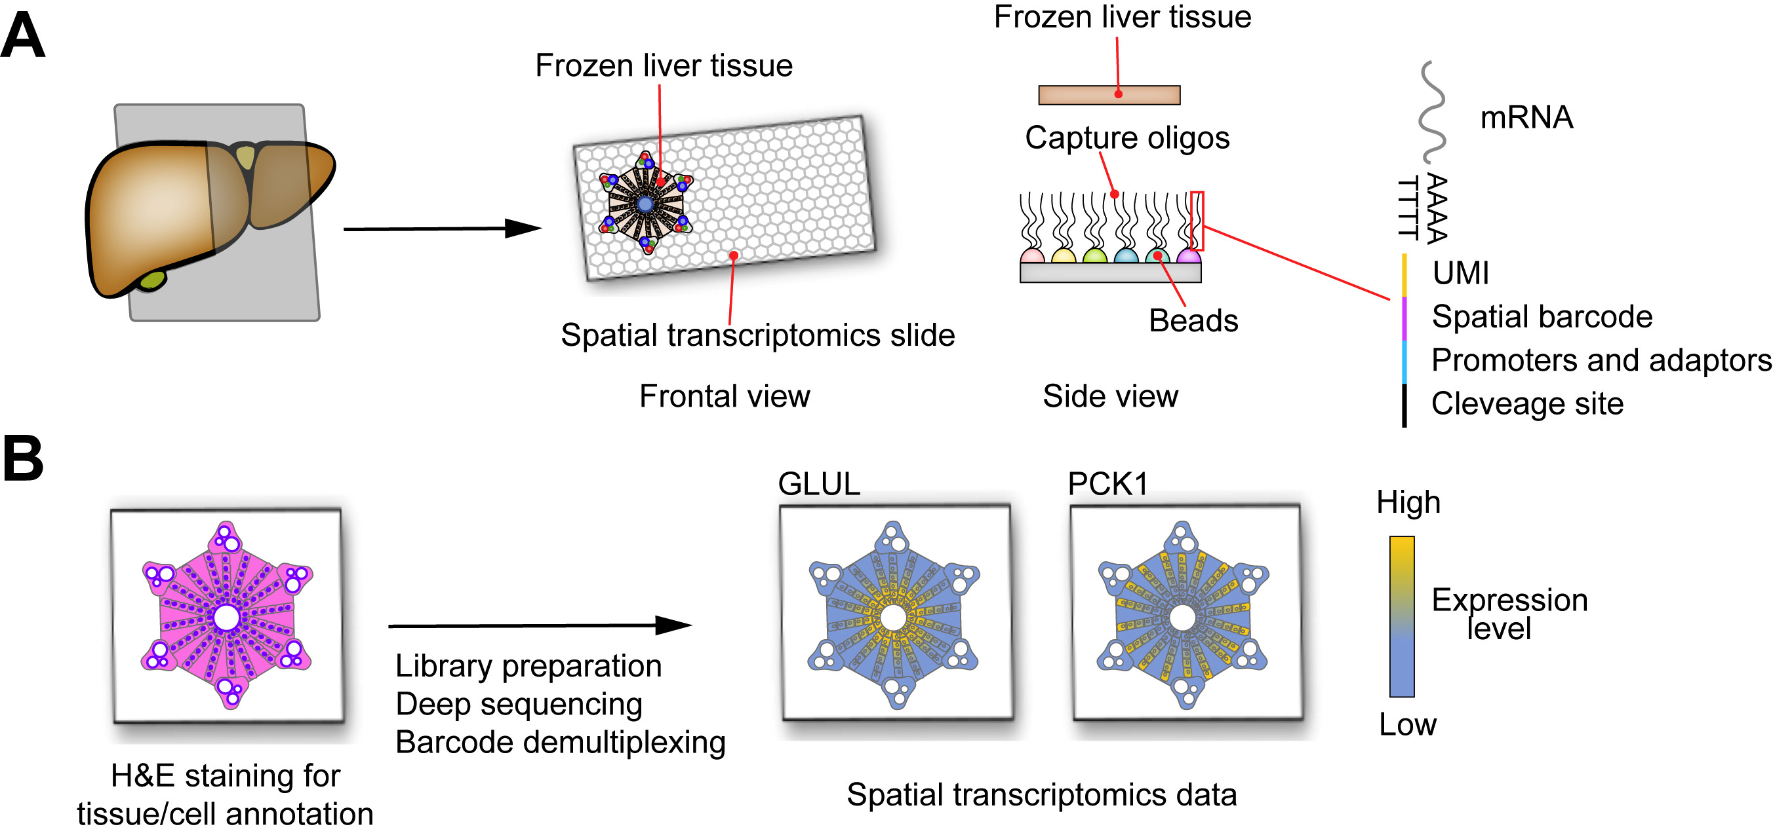
New(er) kids on the block: Spatial methods
Spatial Transcriptomics
Not "single cell" per se but small regions are isolated with specialized equipment
Tissue can be fixed or frozen
Location identity is captured by using barcodes and metadata about the location of the sample
Can measure expression changes from different points in the same tissue, useful for heterogenous samples or complex tissues.
Challenges
Sparse data, the amount of RNA per location is limited
There can be multiple cell types per location

